Slide 1
Lecture 6 The Market Forces of Supply and Demand

Slide 2
The Market Forces of Supply and Demand
Equilibrium
Having analyzed supply and demand separately, we now combine them to see how they determine the price and quantity of a good sold in a market.
Generally equilibrium is a situation in which various forces are in balance and there is no tendency to deviate.
Market equilibrium is a situation in which the market price has reached the level at which quantity supplied equals quantity demanded.

Slide 3
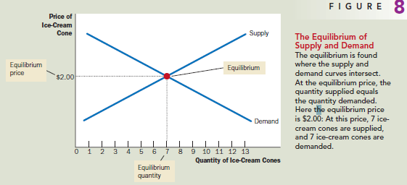
The Market Forces of Supply and Demand
Equilibrium
Graphically, we find the equilibrium at the intersection of the supply and demand curves.

Slide 4
The Market Forces of Supply and Demand
Equilibrium
At the equilibrium price, the quantity of the good that buyers are willing and able to buy exactly balances the quantity that sellers are willing and able to sell.
The equilibrium price is sometimes called the market-clearing price because, at this price, everyone in the market has been satisfied: Buyers have bought all they want to buy, and sellers have sold all they want to sell.
The actions of buyers and sellers naturally move markets toward the equilibrium of supply and demand.

Slide 5
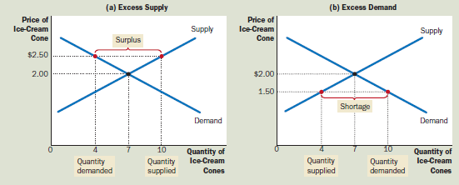
The Market Forces of Supply and Demand
Equilibrium
Consider what happens when the market price is not equal to the equilibrium price.

Slide 6
The Market Forces of Supply and Demand
Equilibrium
At price > equilibrium price: excess supply or surplus (a situation in which quantity supplied is greater than quantity demanded) arises and market forces to lower price.
At prices < equilibrium price: excess demand or shortage (a situation in which quantity demanded is greater than quantity supplied) arises and market forces to raise price.
Equilibrium price is market clearing price: no excess demand or excess supply exists at equilibrium price.

Slide 7
The Market Forces of Supply and Demand
Equilibrium
Thus, the activities of the many buyers and sellers automatically push the market price toward the equilibrium price.
Once the market reaches its equilibrium, all buyers and sellers are satisfied, and there is no upward or downward pressure on the price.
How quickly equilibrium is reached varies from market to market depending on how quickly prices adjust.

Slide 8
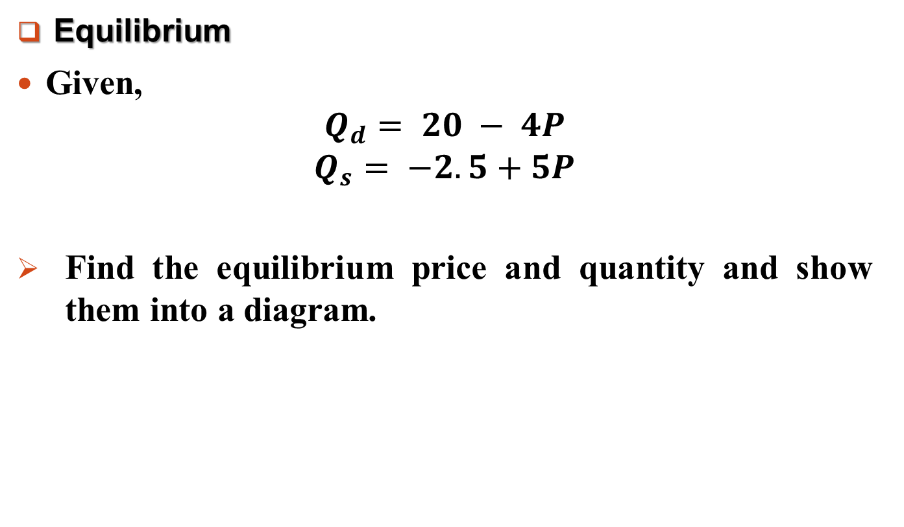
The Market Forces of Supply and Demand
Equilibrium
Given,
$$Q_{d}= 20 − 4P$$
$$Q_{s}= −2.5+5P$$
Find the equilibrium price and quantity and show them into a diagram.

Slide 9
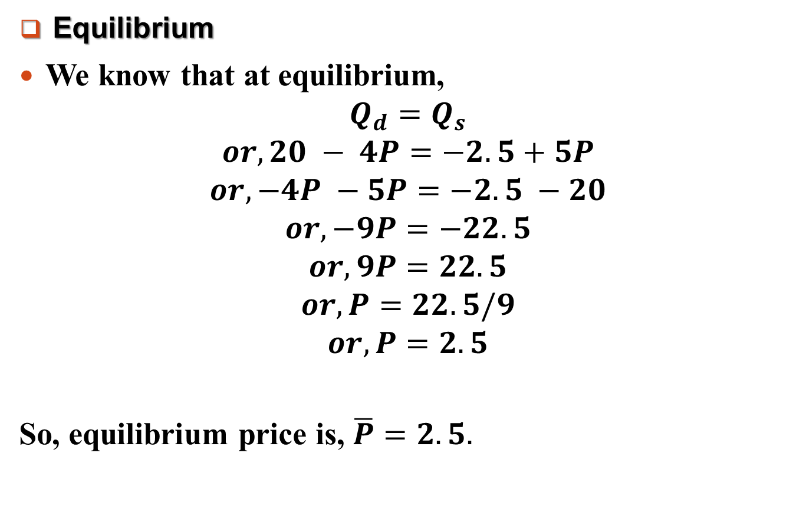
The Market Forces of Supply and Demand
Equilibrium
We know that at equilibrium,
$$Q_{d}=Q_{s}$$
$$or, 20 − 4P=−2.5+5P$$
$$or,−4P −5P=−2.5 −20$$
$$or, −9P=−22.5$$
$$or, 9P=22.5$$
$$or, P=22.5/9$$
$$or, P=2.5$$
So, equilibrium price is, $\overline{P}=2.5.$

Slide 10
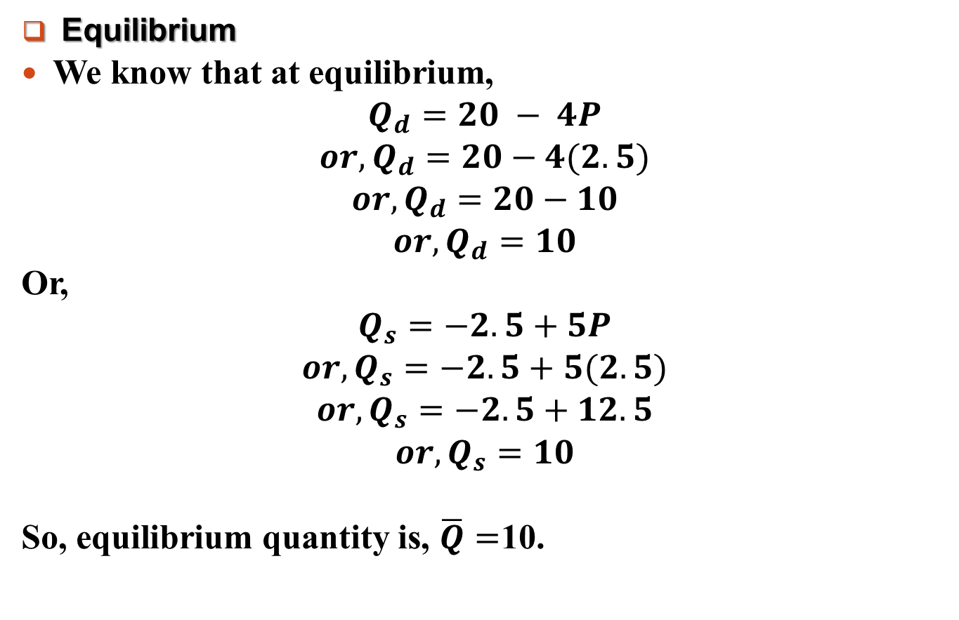
The Market Forces of Supply and Demand
Equilibrium
We know that at equilibrium,
$$Q_{d}=20 − 4P$$
$$or,Q_{d}=20−4(2.5)$$
$$or,Q_{d}=20−10$$
$$or,Q_{d}=10$$
Or,
$$Q_{s}=−2.5+5P$$
$$or,Q_{s}=−2.5+5(2.5)$$
$$or,Q_{s}=−2.5+12.5$$
$$or,Q_{s}=10$$
So, equilibrium quantity is, $\overline{Q}=$10.

Slide 11
The Market Forces of Supply and Demand
Equilibrium: Graphical Representation
Price
5
S
4
3
E*
2.5
2
1
D
Quantity
-2.5
0
5
10
15
20

Slide 12
The Market Forces of Supply and Demand
Three Steps to Analyzing Changes in Equilibrium
So far, we have seen how supply and demand together determine a market’s equilibrium, which in turn determines the price and quantity of the good that buyers purchase and sellers produce.
The equilibrium price and quantity depend on the position of the supply and demand curves.
When some event shifts one of these curves, the equilibrium in the market changes, resulting in a new price and a new quantity exchanged between buyers and sellers.

Slide 13
The Market Forces of Supply and Demand
Three Steps to Analyzing Changes in Equilibrium
When analyzing how some event affects the equilibrium in a market, we proceed in three steps.
First, we decide whether the event shifts the supply curve, the demand curve, or, in some cases, both curves.
Second, we decide whether the curve shifts to the right or to the left.
Third, we use the supply-and-demand diagram to compare the initial and the new equilibrium, which shows how the shift affects the equilibrium price and quantity.
To see how this recipe is used, let’s consider various events that might affect the market for ice cream.

Slide 14
The Market Forces of Supply and Demand
Example: A Change in Market Equilibrium Due to a Shift in Demand.
Suppose that one summer the weather is very hot. How does this event affect the market for ice cream? To answer this question, let’s follow our three steps.
The hot weather changes the amount of ice cream that people want to buy at any given price. The supply curve is unchanged because the weather does not directly affect the firms that sell ice cream.

Slide 15
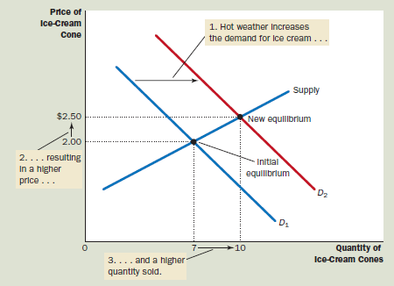

The Market Forces of Supply and Demand
Example: A Change in Market Equilibrium Due to a Shift in Demand.
Because hot weather makes people want to eat more ice cream, the demand curve shifts to the right from $D_{1} to D_{2}.$ This shift indicates that the quantity of ice cream demanded is higher at every price.

Slide 16
The Market Forces of Supply and Demand
Example: A Change in Market Equilibrium Due to a Shift in Demand.
The increase in demand raises the equilibrium price from $2.00 to $2.50 and the equilibrium quantity from 7 to 10 cones. In other words, the hot weather increases the price of ice cream and the quantity of ice cream sold.

Slide 17
The Market Forces of Supply and Demand
Example: A Change in Market Equilibrium Due to a Shift in Supply
Suppose that during another summer, a hurricane destroys part of the sugarcane crop and drives up the price of sugar.
How does this event affect the market for ice cream? To answer this question, let’s follow our three steps.
The change in the price of sugar, an input into making ice cream, affects the supply curve. By raising the costs of production, it reduces the amount of ice cream that firms produce and sell at any given price.
The demand curve does not change because the higher cost of inputs does not directly affect the amount of ice cream households wish to buy.

Slide 18
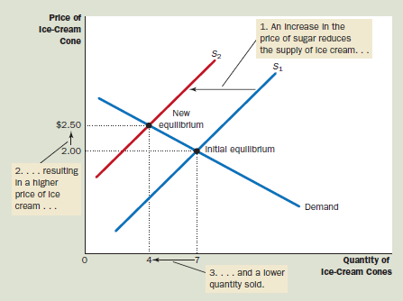

The Market Forces of Supply and Demand
Example: A Change in Market Equilibrium Due to a Shift in Supply
The supply curve shifts to the left from $S_{1}$to $S_{2}$ because, at every price, the total amount that firms are willing and able to sell is reduced.

Slide 19
The Market Forces of Supply and Demand
Example: A Change in Market Equilibrium Due to a Shift in Supply
The shift in the supply curve raises the equilibrium price from $2.00 to $2.50 and lowers the equilibrium quantity from 7 to 4 cones

Slide 20
The Market Forces of Supply and Demand
Example: Shifts in Both Supply and Demand
Now suppose that a heat wav and a hurricane occur during the same summer. To analyze this combination o events, we again follow our three steps.
The hot weather affects the demand curve because it alters the amount of ice cream that households want to buy at any given price. At the same time, when the hurricane drives up sugar prices, it alters the supply curve for ice cream because it changes the amount of ice cream that firms want to sell at any given price.

Slide 21
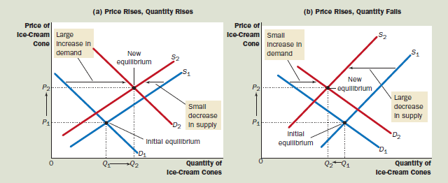
The Market Forces of Supply and Demand
Example: Shifts in Both Supply and Demand
The curves shift in the same directions as they did in our previous analysis: The demand curve shifts to the right, and the supply curve shifts to the left. Figure 12 illustrates these shifts.

Slide 22
The Market Forces of Supply and Demand
Example: Shifts in Both Supply and Demand
As Figure 12 shows, two possible outcomes might result depending on the relative size of the demand and supply shifts. In both cases, the equilibrium price rises.

Slide 23
The Market Forces of Supply and Demand
Example: Shifts in Both Supply and Demand
In panel (a), where demand increases substantially while supply falls just a little, the equilibrium quantity also rises.
By contrast, in panel (b), where supply falls substantially while demand rises just a little, the equilibrium quantity falls.
Thus, these events certainly raise the price of ice cream, but their impact on the amount of ice cream sold is ambiguous (that is, it could go either way).

Slide 24
The Market Forces of Supply and Demand
Three Steps to Analyzing Changes in Equilibrium
We have just seen three examples of how to use supply and demand curves to analyze a change in equilibrium.
Whenever an event shifts the supply curve, the demand curve, or perhaps both curves, you can use these tools to predict how the event will alter the amount sold in equilibrium and the price at which the good is sold.
Table 4 shows the predicted outcome for any combination of shifts in the two curves.

Slide 25
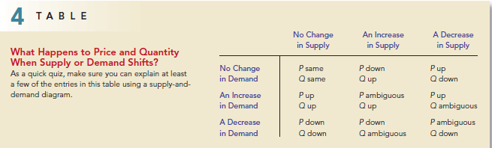
The Market Forces of Supply and Demand
Three Steps to Analyzing Changes in Equilibrium

Slide 26
The Market Forces of Supply and Demand
Quick Test
On the appropriate diagram, show what happens to the market for pizza if the price of tomatoes rises.
On a separate diagram, show what happens to the market for pizza if the price of hamburgers falls.
If both the price of tomatoes rises and the price of hamburgers falls show what happens to the market for pizza.

Slide 27
Readings
N. G. Mankiw- Principles of Microeconomics, 5th Edition, Chapter – 4.

Slide 28


Slide 29
Thank You

